Slide 1
Azure IoT Complete Cloud Offerings for the IoT Revolution
Presenter Name
Title
Contact Info

Slide 2
Topics Covered
The IoT Revolution
Our Industry Leading IoT Offerings
New Offering Announcements

Slide 3
The IoT Revolution

Slide 4
IoT is the Next Revolution
Hardware
is Cheap
Connectivity
is Pervasive
Development
is Easy
New Innovative Scenarios

Slide 5

The IoT Revolution
Moore’s Law
Metcalf‘s Law
Koomey’s Law
Transistors
Computations
per KWh
10,000,000,000
1.E+14
1,000,000,000
1.E+12
100,000,000
1.E+10
10,000,000
1.E+08
1,000,000
1.E+06
100,000
1.E+04
10,000
1.E+02
1,000
1.E+00
1970
1980
1990
2000
2010
1940
1975
2010
And more importantly:
What can you do by combining and analyzing signals from all of these IoT devices?

Slide 6
Harnessing the IoT Revolution
What if my things could tell me when they go someplace they shouldn’t?
What if I could use device telemetry to improve next generation devices?
It all starts with a great idea…
What if I knew when my things were going to break before they did?
What insights could I find from all of my devices?
What if I simply knew where my things were?
What if I could tell when it’s the best time for my things to _______ ?

Slide 7
Harnessing the IoT Revolution
Next comes a device…

Slide 8
Harnessing the IoT Revolution
And data from that device…
0100101010001010100101010010101010100101010101011010101010….

Slide 9
Harnessing the IoT Revolution
And securing the device…
0100101010001010100101010010101010100101010101011010101010….

Slide 10
Harnessing the IoT Revolution
And insights from that data…
0100101010001010100101010010101010100101010101011010101010….

Slide 11
Harnessing the IoT Revolution
Then lots of devices and data…
0100101010001010100101010010101010100101010101011010
010010101000101010010101001010101010010101010101101010101011000101001011
0100101010001010100101010010101010100101010101011010101010001
01001010100010101001010100101010101001010101010110101010101001001010110001010101010
0100101010001010100101010010101010100101010101011010101010101010100010101
0100101010001010100101010010101010100101010101011010101010….
010010101000101010010101001010101010010101010101101010101010001011110101010101010100
010010101000101010010101001010101010010101010101101010101010101
01001010100010101001010100101010101001010101010110101010101010101000101010

Slide 12
Harnessing the IoT Revolution
Then lots of devices and data…
0100101010001010100101010010101010100101010101011010
010010101000101010010101001010101010010101010101101010101011000101001011
0100101010001010100101010010101010100101010101011010101010001
01001010100010101001010100101010101001010101010110101010101001001010110001010101010
0100101010001010100101010010101010100101010101011010101010101010100010101
0100101010001010100101010010101010100101010101011010101010….
010010101000101010010101001010101010010101010101101010101010001011110101010101010100
010010101000101010010101001010101010010101010101101010101010101
01001010100010101001010100101010101001010101010110101010101010101000101010

Slide 13
Harnessing the IoT Revolution
Then monitoring their data in real time…
0100101010001010100101010010101010100101010101011010
010010101000101010010101001010101010010101010101101010101011000101001011
0100101010001010100101010010101010100101010101011010101010001
01001010100010101001010100101010101001010101010110101010101001001010110001010101010
0100101010001010100101010010101010100101010101011010101010101010100010101
0100101010001010100101010010101010100101010101011010101010….
010010101000101010010101001010101010010101010101101010101010001011110101010101010100
010010101000101010010101001010101010010101010101101010101010101
01001010100010101001010100101010101001010101010110101010101010101000101010

Slide 14
Harnessing the IoT Revolution
Then looking for patterns and insights in the data over time…
0100101010001010100101010010101010100101010101011010
010010101000101010010101001010101010010101010101101010101011000101001011
0100101010001010100101010010101010100101010101011010101010001
01001010100010101001010100101010101001010101010110101010101001001010110001010101010
0100101010001010100101010010101010100101010101011010101010101010100010101
0100101010001010100101010010101010100101010101011010101010….
010010101000101010010101001010101010010101010101101010101010001011110101010101010100
010010101000101010010101001010101010010101010101101010101010101
01001010100010101001010100101010101001010101010110101010101010101000101010

Slide 15
Harnessing the IoT Revolution
Then managing and updating the software on these devices…
0100101010001010100101010010101010100101010101011010
010010101000101010010101001010101010010101010101101010101011000101001011
0100101010001010100101010010101010100101010101011010101010001
01001010100010101001010100101010101001010101010110101010101001001010110001010101010
0100101010001010100101010010101010100101010101011010101010101010100010101
0100101010001010100101010010101010100101010101011010101010….
010010101000101010010101001010101010010101010101101010101010001011110101010101010100
010010101000101010010101001010101010010101010101101010101010101
01001010100010101001010100101010101001010101010110101010101010101000101010

Slide 16
Harnessing the IoT Revolution
And visualizing and managing all of these services…
0100101010001010100101010010101010100101010101011010
010010101000101010010101001010101010010101010101101010101011000101001011
0100101010001010100101010010101010100101010101011010101010001
01001010100010101001010100101010101001010101010110101010101001001010110001010101010
0100101010001010100101010010101010100101010101011010101010101010100010101
0100101010001010100101010010101010100101010101011010101010….
010010101000101010010101001010101010010101010101101010101010001011110101010101010100
010010101000101010010101001010101010010101010101101010101010101
01001010100010101001010100101010101001010101010110101010101010101000101010

Slide 17
Harnessing the IoT Revolution
IoT can get complicated quickly
And that’s where Azure comes in

Slide 18
Our Industry Leading IoT Offerings

Slide 19
Azure Services for IoT
Azure IoT Hub
Connect, secure, communicate, monitor and manage billions of devices
Azure Stream Analytics
Real time stream processing for billions of IoT devices
Azure Storage
Blob, SQL, DocumentDB, Data Lake. Storage to meet every need at the scale of IoT
Azure App Service
Web and mobile apps for any platform on any device
Power BI
Dashboards and data connectors to visualize any data
Logic Apps
Powerful workflows to automate business processes
And More…

Slide 20











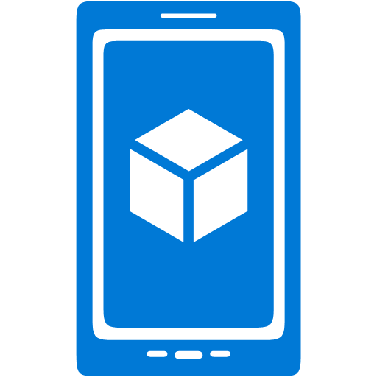




















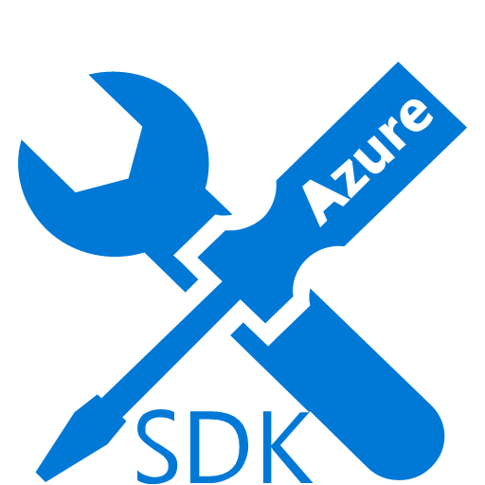













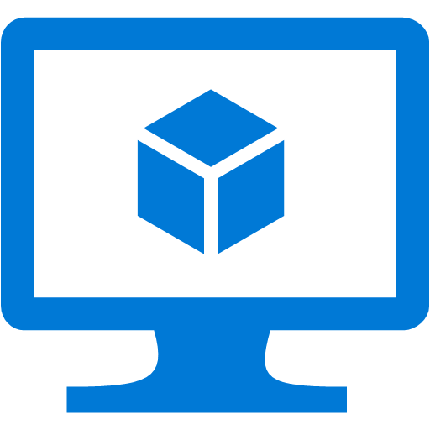








Platform Services
Security & Management
Services Compute
Web and Mobile
Data
Hybrid
Operations
Cloud
Services
Service
Fabric
Web Apps
API Apps
Portal
SQL
Database
Data
Warehouse
DocumentDB
Azure AD
Health Monitoring
Azure Active
Directory
Batch
RemoteApp
AD Privileged
Identity
Management
Mobile
Apps
Logic Apps
Redis
Cache
Azure
Search
Storage
Tables
Azure AD
B2C
Integration
Domain Services
Multi-Factor
Authentication
API
Management
Notification
Hubs
Storage
Queues
BizTalk
Services
Analytics & IoT
Backup
Automation
Hybrid
Connections
Service Bus
Developer Services
HDInsight
Machine
Learning
Stream
Analytics
Data
Lake
Operational
Analytics
Scheduler
Key Vault
Visual Studio
Azure
SDK
Data
Factory
Event
Hubs
Data
Catalog
Import/Export
Media & CDN
Store/
Marketplace
Media Services
Content Delivery
Network (CDN)
VS Online
App
Insights
Mobile
Engagement
Azure Site
Recovery
IoT Hub
VM Image Gallery
& VM Depot
StorSimple
Infrastructure Services
OS/Server Compute
Storage
Networking
Virtual Machines
Container
Service
BLOB Storage
Azure
Files
Premium
Storage
Virtual Network
Load Balancer
DNS
Express
Route
Traffic Manager
VPN Gateway
App
Gateway
Datacenter Infrastructure (30 Regions, 22 Online)

Slide 21
Wouldn’t it be great if someone assembled this for you?

Slide 22
Azure IoT Suite Get started in minutes & customize to meet your needs
Devices
Azure IoT SDK (OSS)
Linux, RTOS, mBed, Windows,
Android, iOS
Business Process
ERP/CRM
Web App
Storage Blobs
DocumentDB
IoT Hub
Stream Analytics
Event Hub
Web Jobs
Logic Apps
Azure
Active Directory

Slide 23
Demo: Azure IoT Suite

Slide 24
Azure IoT Suite Remote Monitoring Service Architecture
Devices
Azure IoT SDK (OSS)
Linux, RTOS, mBed, Windows,
Android, iOS
Business Process
ERP/CRM
Web App
Storage Blobs
DocumentDB
IoT Hub
Stream Analytics
Event Hub
Web Jobs
Logic Apps
Azure
Active Directory

Slide 25
Azure IoT Hub
Designed for IoT
Connectivity, Security & Management for billions of devices
Service Assisted Communications
Devices are not servers
Use IoT Hub to enable secure bi-directional communications
Cloud Scale Messaging
Device-to-cloud and Cloud-to-device
Durable message inbox/outbox per device
Monitor Devices
Delivery receipts, expired messages
Device communication errors
Per-Device Authentication
Individual device identities and credentials
Connection Multiplexing
Single device-cloud connection for all communications
(device-to-cloud, cloud-to-device)
Multi-Protocol
Natively supports AMQPS, HTTPS, MQTT
Extensible protocol support for custom protocol needs
Multi-Platform
Device SDKs available for multiple platforms
RTOS, Linux, Windows, iOS, Android
Service SDK supports multiple languages (Node, Java, C#)

Slide 26
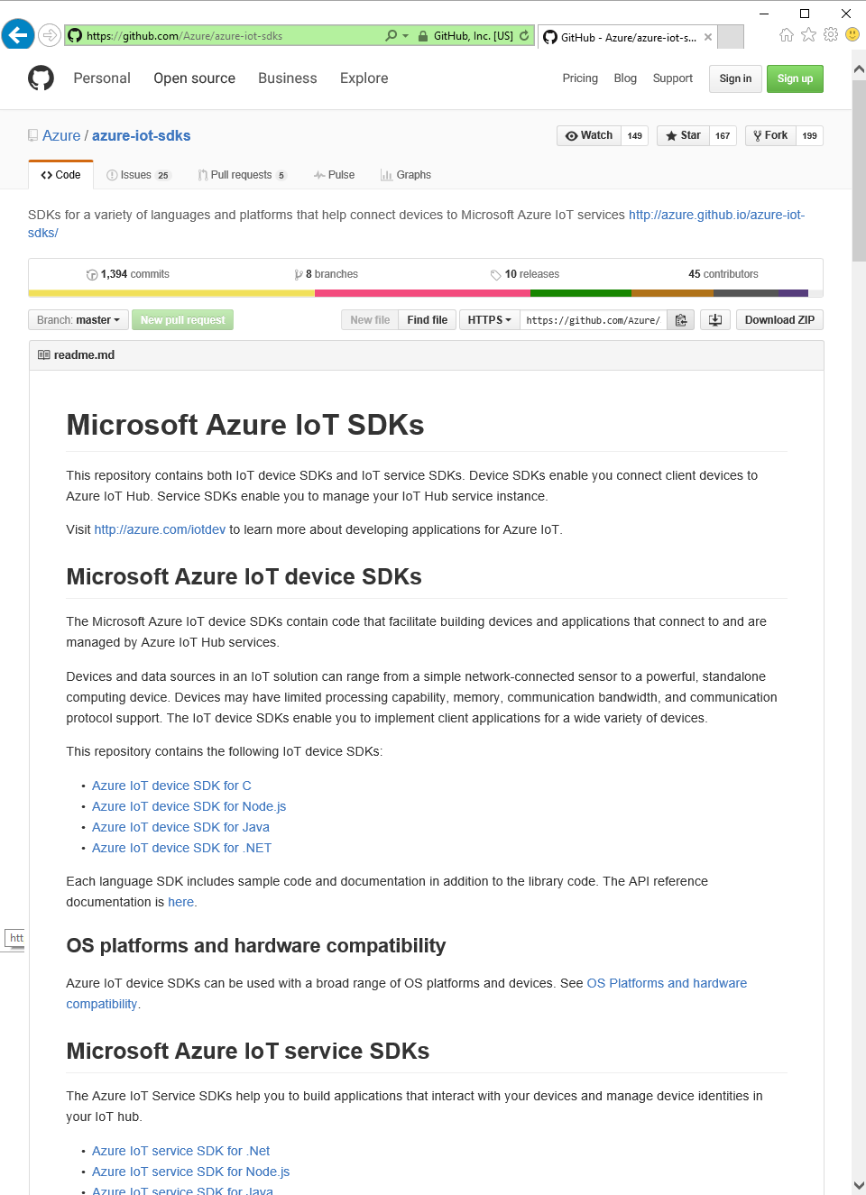
Azure IoT Device SDK
Open Source
Everything is on GitHub, open source under MIT license
Cross-Platform Support
RTOS, Linux, Windows, iOS, Android
Multi-Language Support
C, Node.js, Java, C#, Python
Xamarin Compatible
Includes Xamarin compatible libraries
Easy To Get Started
Samples, walkthroughs to get you started quickly

Slide 27
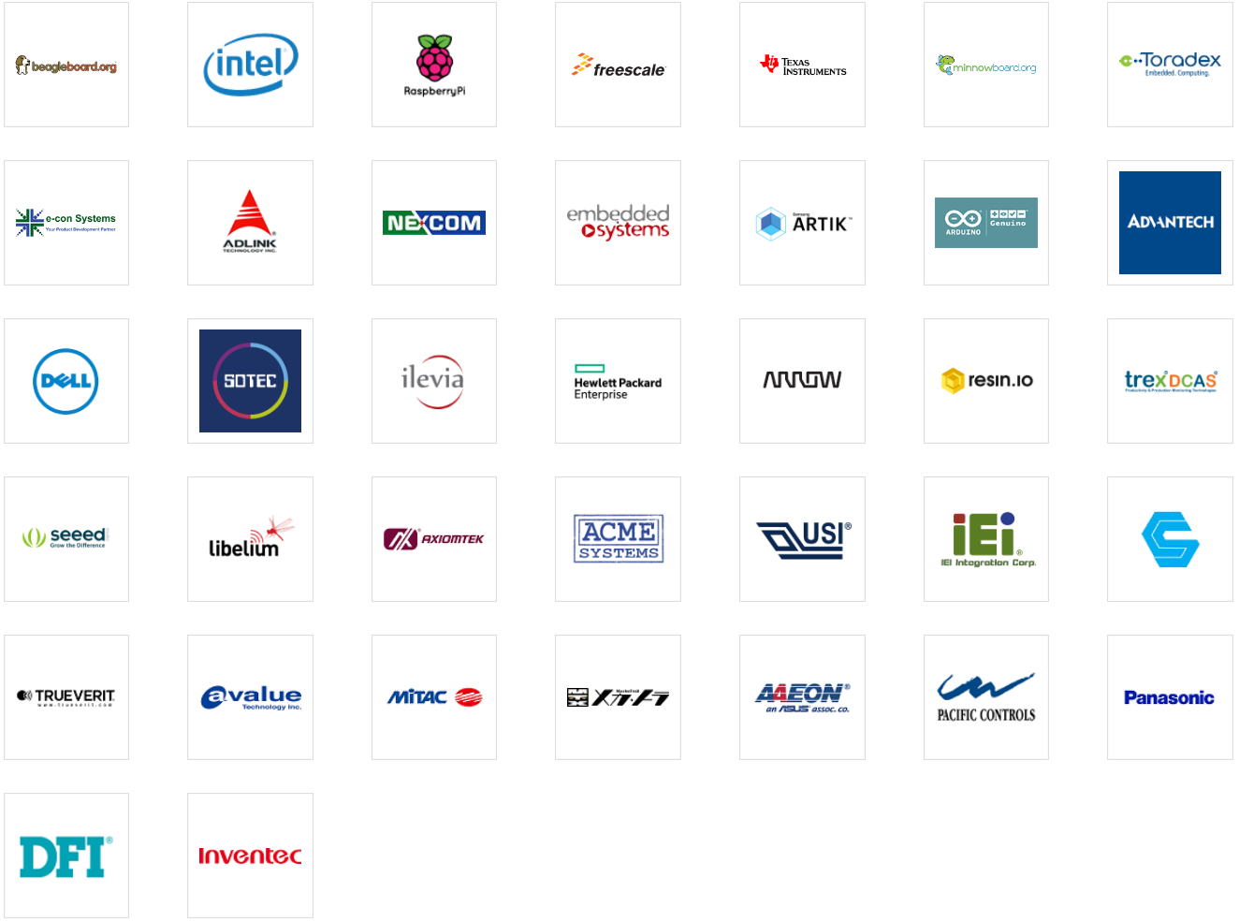
Azure Certified for IoT
Certified to Work Great with Azure IoT
Operating systems & devices
Over 50 Partners & Growing
Azure IoT Device SDK Supports Even More!
Azure IoT Device SDK supports more than Azure Certified for IoT and is easy to adapt to new devices and operating systems

Slide 28
Demo: Azure IoT Hub & Azure IoT Device SDK Cross Platform Support

Slide 29
New Offering Announcements

Slide 30
New Offering Announcements
Azure IoT Hub Device Management
Update firmware, software, configuration on any device running any operating system
Organize and update devices based on hierarchical topologies
Azure IoT Gateway SDK
Cross platform middleware for field gateways
Connect, manage and monitor multiple devices
Protocol translation & data normalization
Azure IoT Starter Kits
5 new kits to get started quickly
New Region Availability

Slide 31
Azure IoT Hub Device Management
Update Software, Firmware, Configuration
Going beyond simple ‘Create, Remove, Update and Delete’ for devices
Fully extensile - works on any device running any operating system or firmware
Standards Based
Based on OMA LWM2M
Manage Devices The Way You Want
Group devices into custom topologies
Update devices based on sub-sections of that topology
Role based access control
Enables IT/OT Coordination
OT is responsible for keeping things running, IT is responsible for keeping things secure
IoT requires IT/OT coordination

Slide 32
Azure IoT Hub – Device Topology Support
Group & Manage Devices Based On Your Scenario
Example: Building Management

Slide 33
Azure IoT Hub – Device Topology Support
Group & Manage Devices Based On Your Scenario
Building: 1
Floor: 1
Floor: 2
Room: 1
Room: 2
Room: 3
Room: 1
Room: 2
Room: 3
Room: 4
Room: 5
Room: 6
Room: 4
Room: 5
Room: 6

Slide 34
Azure IoT Hub – Device Topology Support
Update Devices Based on Sub-Topologies
Building: 1
Update Floor 1
Floor: 1
Floor: 2
Room: 1
Room: 2
Room: 3
Room: 1
Room: 2
Room: 3
Room: 4
Room: 5
Room: 6
Room: 4
Room: 5
Room: 6

Slide 35
Azure IoT Hub – Device Topology Support
Create Permissions Groups Based on Device Topology
Building: 1
Permissions: Group 1
Permissions: Group 2
Floor: 1
Floor: 2
Room: 1
Room: 2
Room: 3
Room: 1
Room: 2
Room: 3
Room: 4
Room: 5
Room: 6
Room: 4
Room: 5
Room: 6

Slide 36
Azure IoT Hub Device Management
Enroll Devices
Enroll devices and determine properties and available operations
Organize Devices
Group & manage based on your scenario
Role based access to sub-groups
Maintain Devices
Update software, firmware, configuration using “device jobs”
Operators can monitor device health and signal when it is safe to update devices
IT can update and rollback during maintenance windows
Decommission Devices
Decommission and replace devices after service lifetime

Slide 37
Azure IoT Hub Device Management
Azure IoT Suite
Azure IoT Hub
Application
Your Code
Device
Device Management Objects
Device (Object)
Device State
Device App
(Your Code)
LWM2M over CoAP/TCP
Device Management APIs
Registry Manager API
Create, Update, Delete Devices
DM Client Library
Device Groups API
Groups CRUD, Add/Remote Devices, Events, Access Control
Device Query API
Tags, Device and Service Properties
Device Jobs API
Create, Monitor, Cancel

Slide 38
Demo: Azure IoT Hub Device Management

Slide 39
Device Job - Firmware Update Example
A Device Job is a multi-step device orchestration
on a set of devices managed by Azure IoT Hub
Azure IoT Suite
Device
Azure IoT Hub
Your code
on the device
IoT Hub DM
client library
Device Job
Your code
in the cloud
Download
Package URI
Download Package URI
Write Firmware Package URI,
Trigger Client
Step 1:
Start Firmware Update Job providing the Package URI
Step 1
Download the firmware
Monitor State Changes and Apply Update
Anytime during job execution: Check the status of the Job
Step 2
Download Completed
Apply the Update
Apply Update
Step 3
On Job Completed: Receive callback in cloud
Reconnect after restart

Slide 40
Demo Wrap-up: Azure IoT Hub Device Management

Slide 41
Azure IoT Gateway SDK
Open source IoT gateway middleware that enables:
Cloud connectivity for devices that don't speak TCP/IP
Security Isolation for devices can't be updated/secured
Protocol translation for existing and new protocols
Data transformation compression, annotation, filtering
Local intelligence local processing for low latency needs

Slide 42
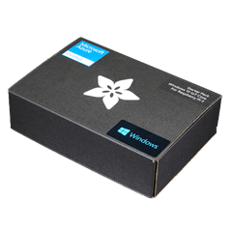
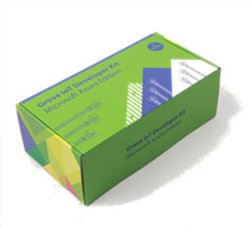
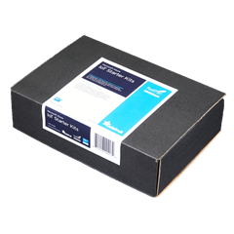
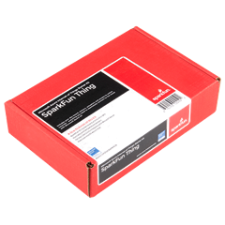
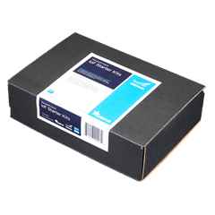
Azure IoT Starter Kits Get started quickly
Raspberry Pi 2 Kit
Windows 10 and Raspbian
Samples in C and C#
Intel Edison Kit
Linux Yocto
Samples in JavaScript (Node.js)
Feather M0 Wi-Fi Kit
RTOS
Samples in Arduino IDE and C
ThingDev Kit
RTOS
Samples in Arduino and C
Feather Huzzah ESP8266 Kit
RTOS
Samples in Arduino IDE and C
Start today: http://azure.com/iotstarterkits

Slide 43
Lab Overview

Slide 44
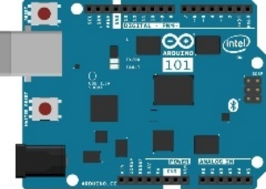
Lab Architecture
Resource Group <name>group
Development Workstation (Windows / OSx / Linux)
GET / POST
SEND / RECEIVE
SEND CLOUD-TO-DEVICE MESSAGES
App Service Plan <name>plan
Web App <name>web
IoT Hub <name>iot
SQL Server
<name>sql
PowerBI Embedded Workspace Collection <name>collection
PowerBI Embedded Workspace
Dynamically generated guid
Report TemperatureChart
Router w/ Internet Access
SQL Db
<name>db
LOCAL RESOURCES
AZURE RESOURCES
OUTPUT
QUERY
RENDER
Stream Analytics
<name>job
DIRECT QUERY
INPUT
SEND / RECEIVE
Intel NUC / IoT Gateway
Arduino 101 & Grove Base Shield
OUTPUT
Function App
<name>functions
Buzzer
Event Hub Namespace
<name>ns
Function TempAlert
Event Hub <name>alerts
Storage Account <name>storage
Temperature Sensor
RECEIVE
SEND CLOUD-TO-DEVICE-MESSAGES
READ / WRITE
Rotary Angle Sensor
2 Row LCD Display

Slide 45
Prerequisites
Now is a great time to setup or install these if you don’t have them already. There are copies of the software on the yellow USB drives…
An active Microsoft Azure Subscription.
Node.js 4.x or later. You can install Node.js from nodejs.org
Visual Studio Code. You can install it from code.visualstudio.com
Git installed and in your system path. Install it from:
git-scm.com/downloads or if you prefer GitHub…
desktop.github.com
Make sure your git global config is setup: git config --global user.name "Your Name“ git config --global user.email "Your Email"

Slide 46
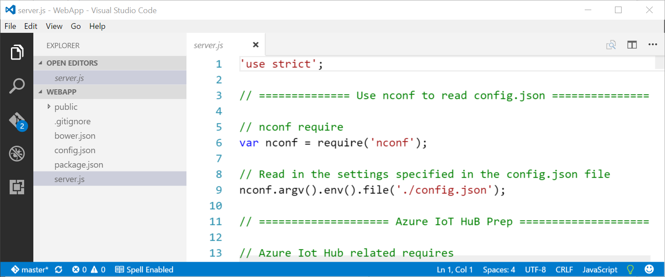
Visual Studio Code
We’ll be using Visual Studio Code as development environment in this lab. It is a light weight, free, open source, cross-platform development tool, and we think you’ll love it!

Slide 47
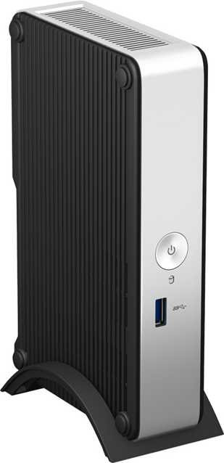
Give the intel nuc time! SERIOUSLY!
The Intel IoT Gateway “NUC” is an Atom Based computer with a “Wind River” Yocto Based Linux Image on it.
It’s running an nginx web server instance that hosts the “Intel IoT Gateway Developer Hub” (Dev Hub) and Node-RED, plus it’s going to do all the sending and receiving of messages to Azure!
Most laptops don’t boot up seconds, so don’t expect the NUC to either. Give it time to boot, load, and be awesome!

Slide 48
Best practices FOR A FUN LAB…
Use the <name>xyz naming convention. It helps!
Put all of your Azure resources in a single, new “Resource Group” created just for this lab. This will make it super easy to clean up!
Put all of your Azure resources in a single “Region” that is near you. That will help keep things fast and low cost.
Work with you neighbors! You'll learn more!
We are here to help, but try thinking about how to solve your issue before you ask for help!

